Slide 1
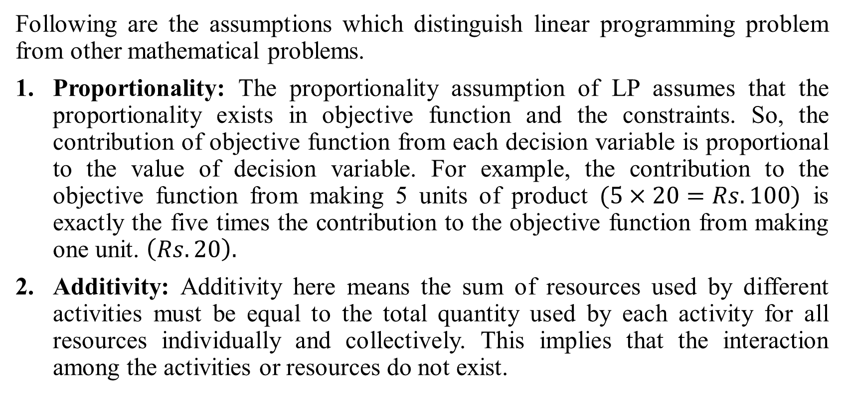
ASSUMPTIONS OF LINEAR PROGRAMMING
Following are the assumptions which distinguish linear programming problem from other mathematical problems.
Proportionality: The proportionality assumption of LP assumes that the proportionality exists in objective function and the constraints. So, the contribution of objective function from each decision variable is proportional to the value of decision variable. For example, the contribution to the objective function from making 5 units of product $(5×20=Rs.100)$ is exactly the five times the contribution to the objective function from making one unit. $\left(Rs. 20\right).$
Additivity: Additivity here means the sum of resources used by different activities must be equal to the total quantity used by each activity for all resources individually and collectively. This implies that the interaction among the activities or resources do not exist.

Slide 2
3. Divisibility: The divisibility assumption requires that each decision variable be allowed to assume any non – negative valued, i.e., integer as well as fractional values. Sometimes, these values only make sense if they are integers. Then, we need an extension of LP called integer programming.
4. Certainty: The certainty assumption is that each parameter (objective function coefficient, Right hand side and technological coefficients) is known with certainty.

